Slide 1

Swiggy analysis
Parimala Gowri S-MBE11

Slide 2
Agenda
About Swiggy
Market Overview
Analysis and Insights
Dashboard
Business Recommendations

Slide 3

About Swiggy
Swiggy is an Indian online food ordering and delivery company. Founded in 2014, Swiggy is headquartered in Bangalore and operates in more than 580 Indian cities, as of July 2023. Besides food delivery, the platform also provides quick commerce services under the name Swiggy Instamart, and same-day package deliveries with Swiggy Genie.

Slide 4

Market overview

Slide 5

Market overview
Swiggy, launched in 2014, is one of India’s largest online food delivery platforms, known for its widespread coverage, fast delivery services, and user-friendly app experience. Founded by Sriharsha Majety, Nandan Reddy, and Rahul Jaimini, Swiggy initially focused on creating a hyper-local, on-demand logistics service to connect customers with restaurants. It has since expanded to a multi-faceted platform offering groceries, packages, and other delivery solutions. Here’s an overview of Swiggy's market standing, competition, and strategic approaches:

Slide 6

Market overview:
Here’s an overview of Swiggy's market standing, competition, and strategic approaches:
Market position and growth:
Swiggy operates in an intensely competitive food delivery market dominated by two major players: Swiggy and Zomato.
Despite challenges from competitors and fluctuating consumer demand, Swiggy has managed to build a significant presence across India, servicing over 500 cities.
Its growth has been fueled by rising disposable income, urbanization, an increasing shift towards convenience, and a young, tech-savvy population that values delivery options.

Slide 7

Consumer Demographics
Swiggy’s revenue grew substantially post-2020 as demand for home-delivery services spiked during the COVID-19 pandemic.
Swiggy primarily targets young professionals and urban families who prefer food delivery over traditional dining-out experiences.
The majority of Swiggy’s user base consists of tech-friendly millennials and Gen Z customers in Tier 1 and Tier 2 cities, though Swiggy has actively expanded its reach into Tier 3 and Tier 4 cities.
The demand in smaller cities is growing as awareness and digital adoption increase.

Slide 8
Competitive landscape
Swiggy’s main competitor is Zomato, which offers a similar service range and has a nearly equal market share.
Other competitors include Amazon Food, Dunzo, and Uber Eats (though the latter exited the Indian market, selling its operations to Zomato in 2020).
Swiggy differentiates itself through initiatives such as “Swiggy Genie” for on-demand package deliveries and “Instamart” for groceries, positioning itself as a more holistic delivery solution.

Slide 9
Strategic Recommendations:
Swiggy has leveraged several innovations to maintain and grow its market share:
Swiggy Instamart: Launched to tap into the burgeoning grocery delivery market, Instamart caters to consumers seeking instant deliveries of daily essentials.
Swiggy Genie: A courier service for miscellaneous deliveries, Genie caters to diverse needs, from sending packages to grocery shopping.
Subscription Models: The “Swiggy One” subscription service offers discounts on deliveries, free deliveries, and exclusive offers. This helps build customer loyalty while boosting order frequency.
Cloud Kitchens: Swiggy has invested in cloud kitchen services to increase restaurant reach and expand food options without a high overhead cost

Slide 10
Technology and Data utilization
Swiggy has built a sophisticated technology ecosystem that powers its operations, enabling efficient and user-friendly experiences. Its focus on technology spans various aspects of the customer journey, from order placement to real-time tracking, and optimizes processes to deliver faster and more reliably. Swiggy leverages data science, artificial intelligence (AI), machine learning (ML), and predictive analytics to manage and improve multiple operational layers. Here’s how Swiggy uses technology and data:
Real – Time order matching and allocation
Route Optimization and delivery efficiency
Predictive analytics for demand forecasting
Personalized customer experience
AI-powered chatbots for customer support
Smart Restaurant management systems
Dynamic pricing and offers
Customer and driver safety
Data Security and privacy

Slide 11
Challenges and Future Outlook
While Swiggy enjoys a strong market position, it faces significant challenges, including regulatory changes, fluctuating commission structures, increasing fuel prices affecting delivery costs, and the need to constantly innovate to retain customers.
Furthermore, as India’s e-commerce ecosystem becomes more competitive, Swiggy must stay agile and diversify its services to maintain profitability.
In the future, Swiggy aims to deepen its presence in smaller towns and diversify its service offerings further.
If it successfully manages rising costs and intensifying competition, Swiggy is well-positioned to be a leader in the on-demand service market in India.

Slide 12
Financials
YEAR | Revenue (in million) | Expenses (in million) | Net profit (in million)
2024 | 70,166 | 88,020 | -18,880
2023 | 53,613 | 88,860 | -37,576

Slide 13

Analysis and Insights

Slide 14
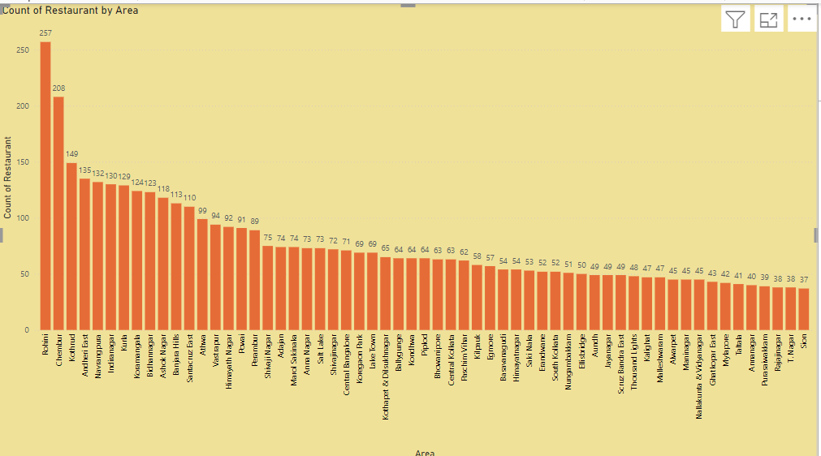
Top 10 areas with most restaurants in Bangalore city
Rohini with 257 restaurants
Chembur with 208 restaurants
Kothrud with 149 restaurants
Andheri East with 135 restaurants
Navrangpura with 132 restaurants
Indiranagar with 130 restaurants
Kurla with 129 restaurants
Koramangala with 124 restaurants
Bidhannagar with 123 restaurants
Ashoknagar with 118 restaurants

Slide 15
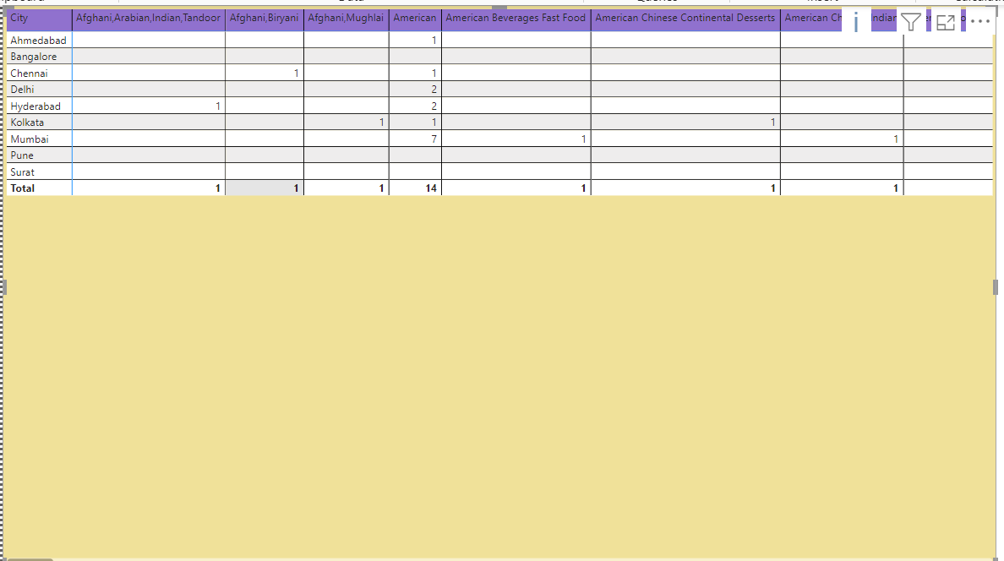
Most Popular Food Types Served by Swiggy Restaurants in Each City is American, Fast food, Continental, Beverages, Snacks, and Desserts.

Slide 16
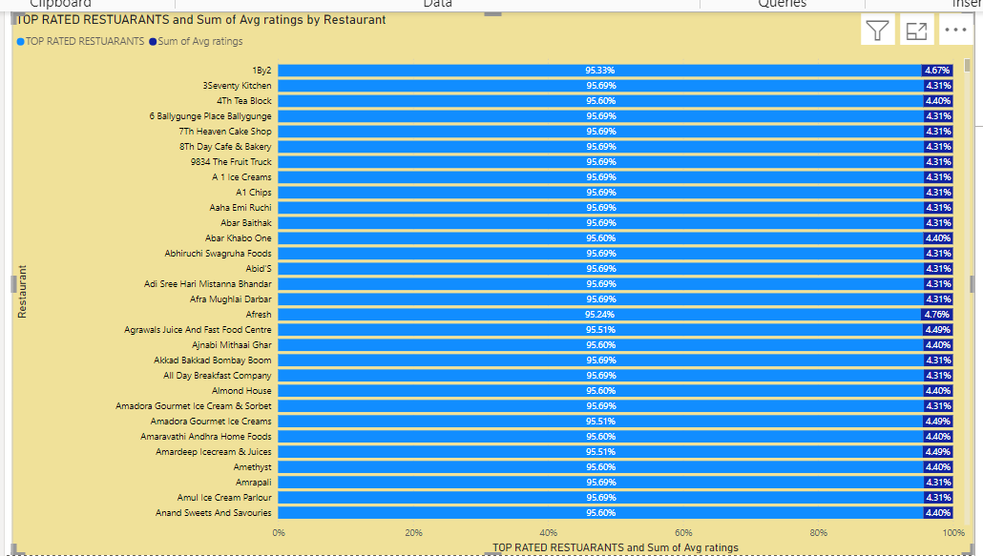
Top Rated Swiggy Restaurants (In Percentage)
TOP RATED RESTAURANTS =
DIVIDE(
COUNTROWS(FILTER('swiggy - swiggy csv csv', 'swiggy - swiggy csv csv'[Avg ratings] >= 4.5)),
COUNTROWS('swiggy - swiggy csv csv')
) * 100
I used this formula in the new measure to derive the top-rated swiggy restaurants in percentage.

Slide 17
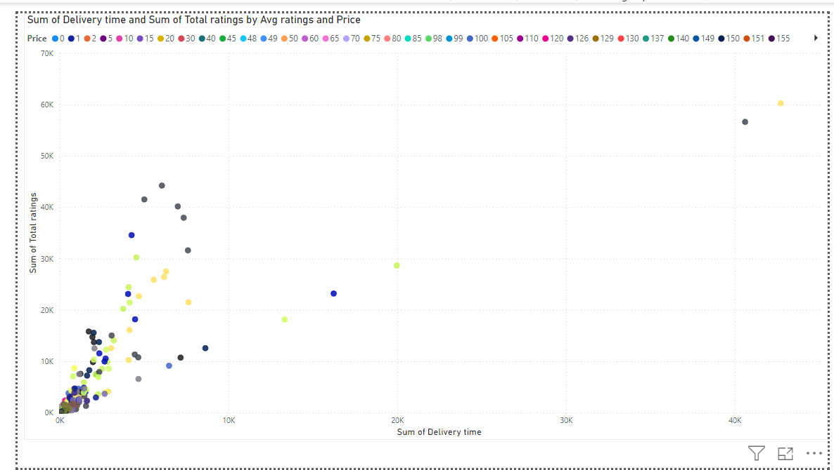
Correlation of Factors Affecting Average Rating

Slide 18
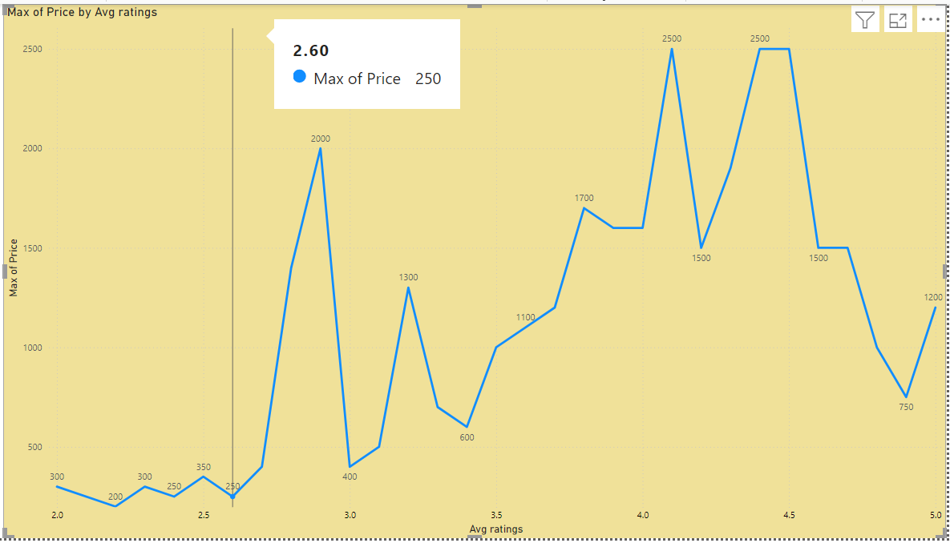
Correlation Between Restaurant Price and Average Rating

Slide 19
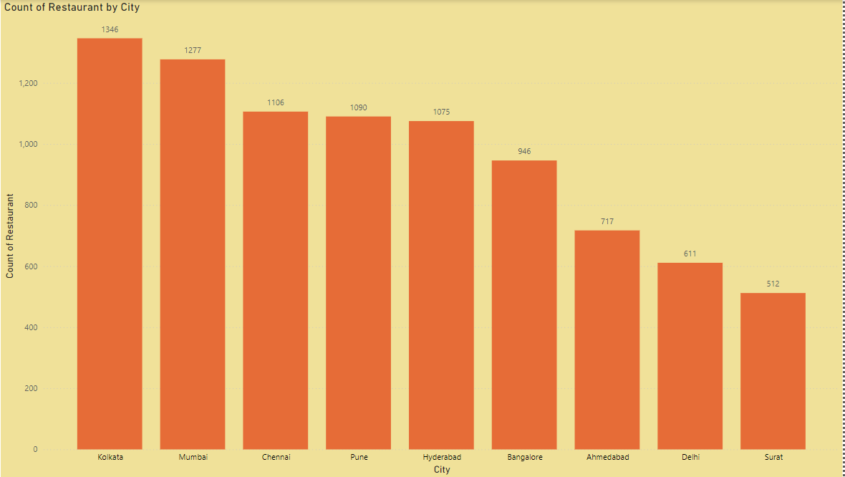
City-wise Restaurant Count

Slide 20
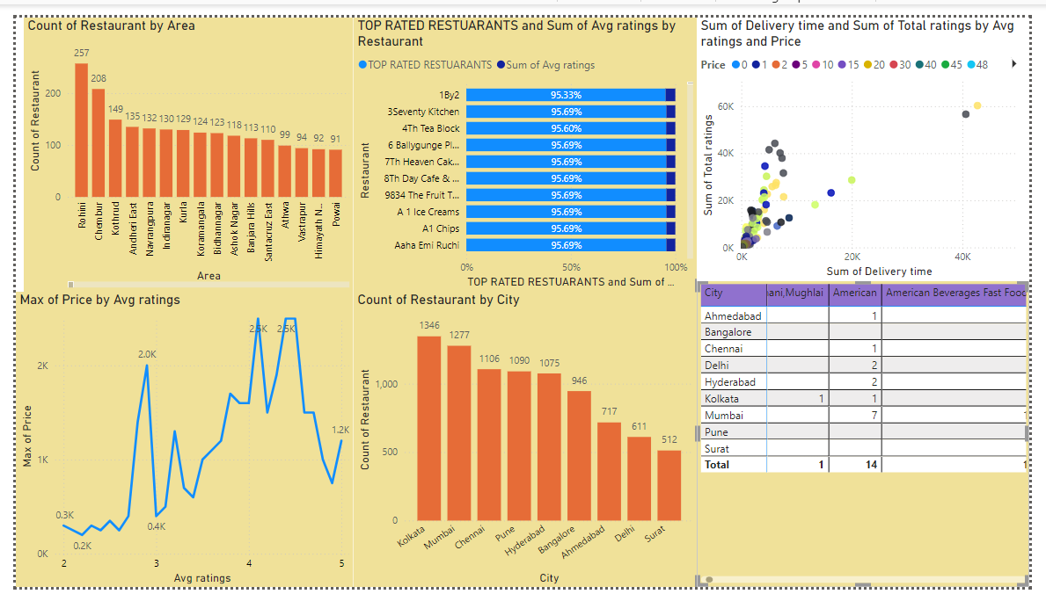
DASHBOARD 1

Slide 21
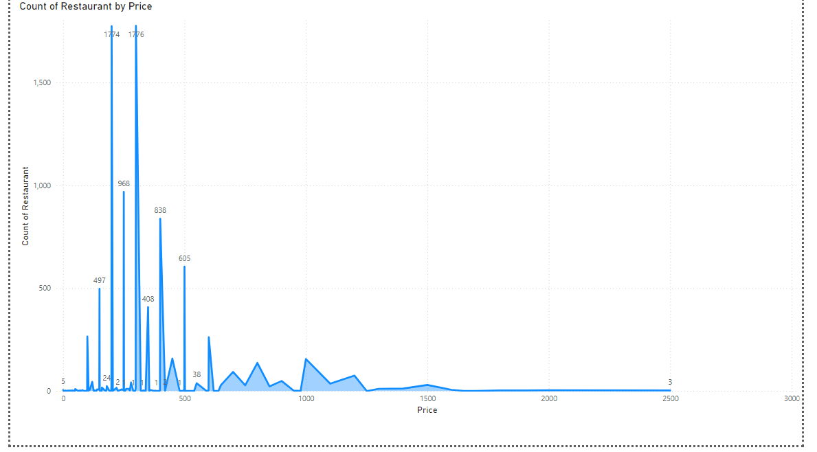
Price Analysis

Slide 22
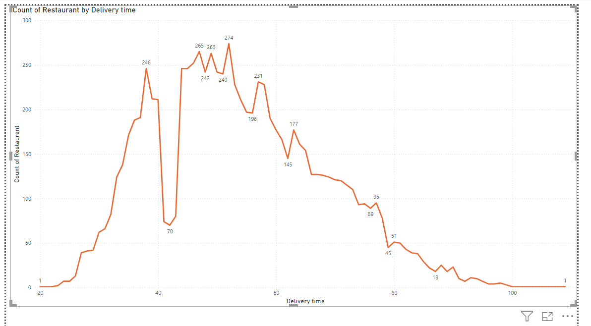
Delivery time analysis

Slide 23
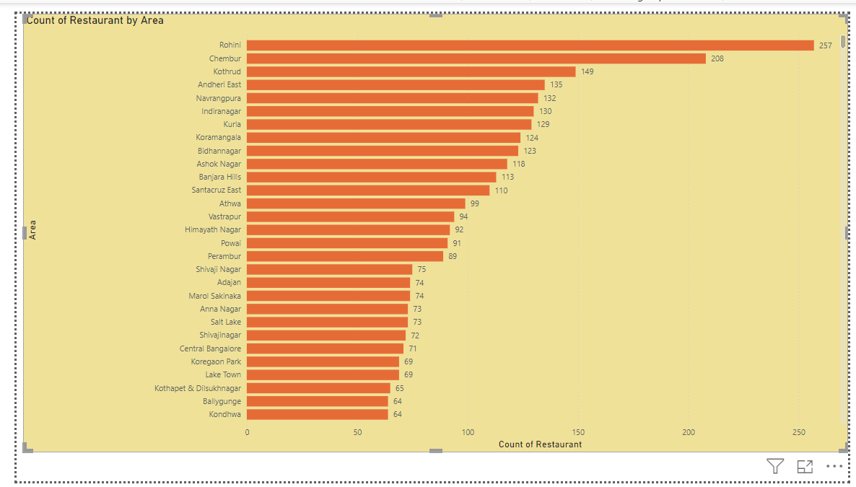
Area-wise Restaurant Analysis

Slide 24
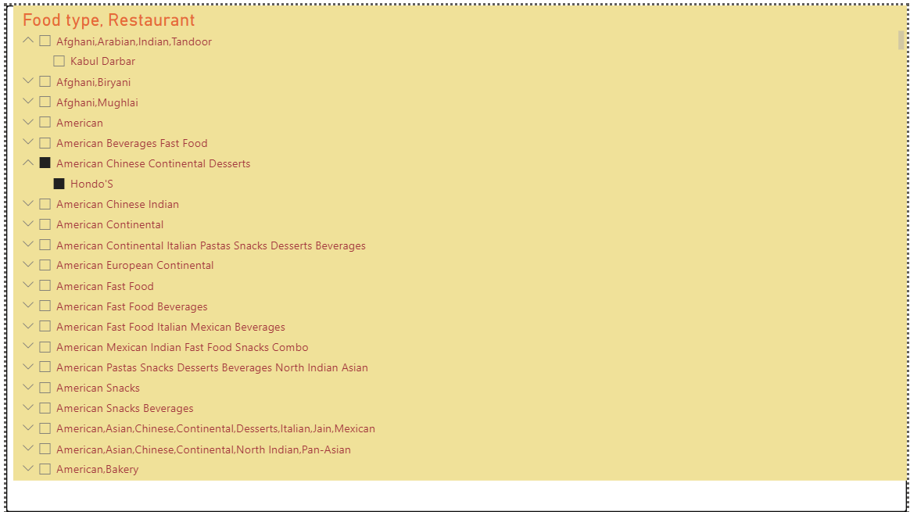
Cuisine Analysis

Slide 25
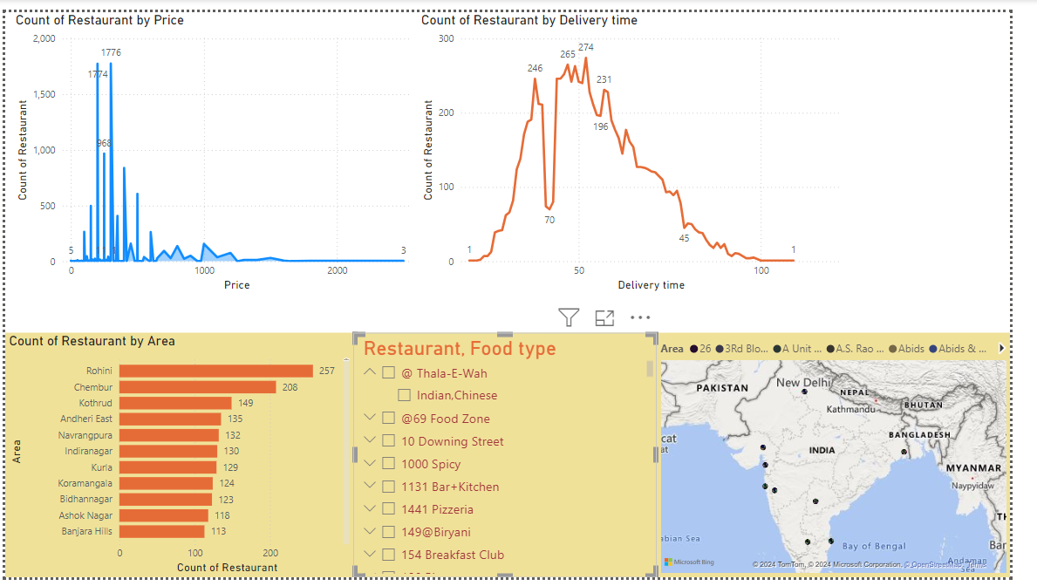
Dashboard 2

Slide 26
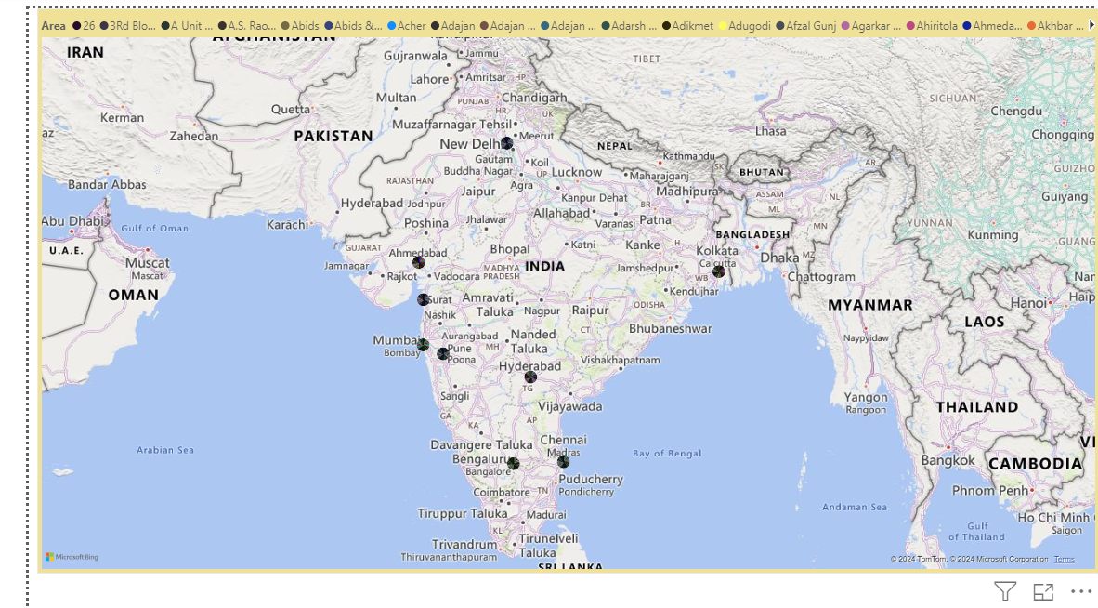
Geographical Mapping

Slide 27
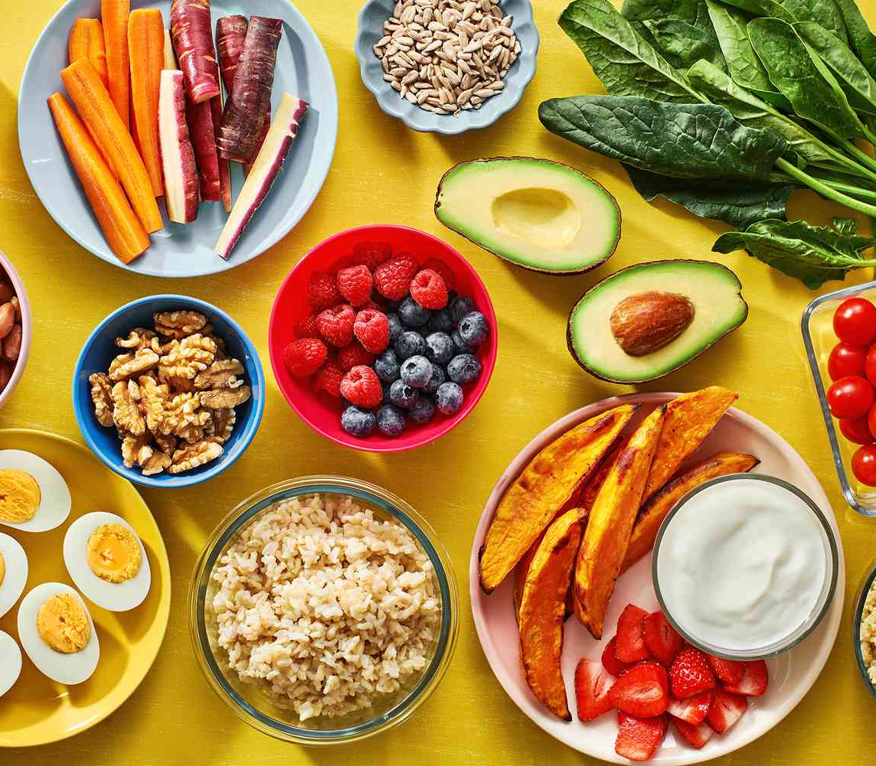
Business Recommendations

Slide 28
Operational improvements
Delivery Time Optimization:
Delivery times vary significantly, suggesting optimization opportunities. Analyzing patterns by area could help identify high-delay regions where Swiggy might benefit from adjusting logistics or adding more delivery resources.
Considering food types and preparation times can aid in optimizing delivery estimates, helping Swiggy prioritize faster-preparing restaurants during peak hours.
Quality and Partner Review:
Identify restaurants with high ratings (e.g., 4.4 or higher) and promote partnerships with them to drive customer satisfaction.
Conversely, for restaurants with lower ratings, Swiggy could implement improvement plans or prioritize higher-rated options in search results to maintain quality service.
Dynamic Pricing and Discounts:
Offering targeted discounts or delivery fee adjustments based on the area or cuisine type can help manage demand and improve delivery time consistency in busier areas, especially in places with high total ratings and frequent delays.

Slide 29
Market Strategy Recommendations
Targeted Marketing by Cuisine and Area:
Since some areas show popular cuisines (e.g., Mughlai in Koramangala or Chinese in Jogupalya), Swiggy can leverage this for customized marketing campaigns that showcase trending dishes by region to drive local engagement.
Promotions for High-Rated Restaurants:
Highlighting highly-rated restaurants or “Swiggy-recommended” listings in specific areas could help build brand credibility and trust.
These promotions can also increase customer retention by assuring quality experiences.
Expansion in High-Demand Areas:
In areas with high delivery times and order volumes, Swiggy could consider adding more partner restaurants to reduce the load on existing ones, potentially improving both delivery time and customer satisfaction.

Slide 30

Thank you
Parimala Gowri S | MBE11

